Slide 1
Portfolio milestone presentation
Syracuse University – Applied Data Science
LAURA LAMOUREUX
LLAMOURE@SYR.EDU
SUID: 823691551
Notes:
Hello – I am Laura Lamoureux. Welcome to my Portfolio Milestone Presentation

Slide 2
Presentation Outline
About Me
Work Experience
Education Experience
Applied Data Science
Learning Objectives
Learning Objective 1
Learning Objective 2
Learning Objective 3
Learning Objective 4
Learning Objective 5
Learning Objective 6
Learning Objective 7
Conclusion
Thank You
Notes:
This is the agenda for the presentation:
I will introduce myself, my work and my education experiences
Next will be an overview of the Applied Data Science Learning Objectives
Then a deeper dive into each Learning Objective
The presentation will conclude with a restating of the objectives (in my own words)

Slide 3
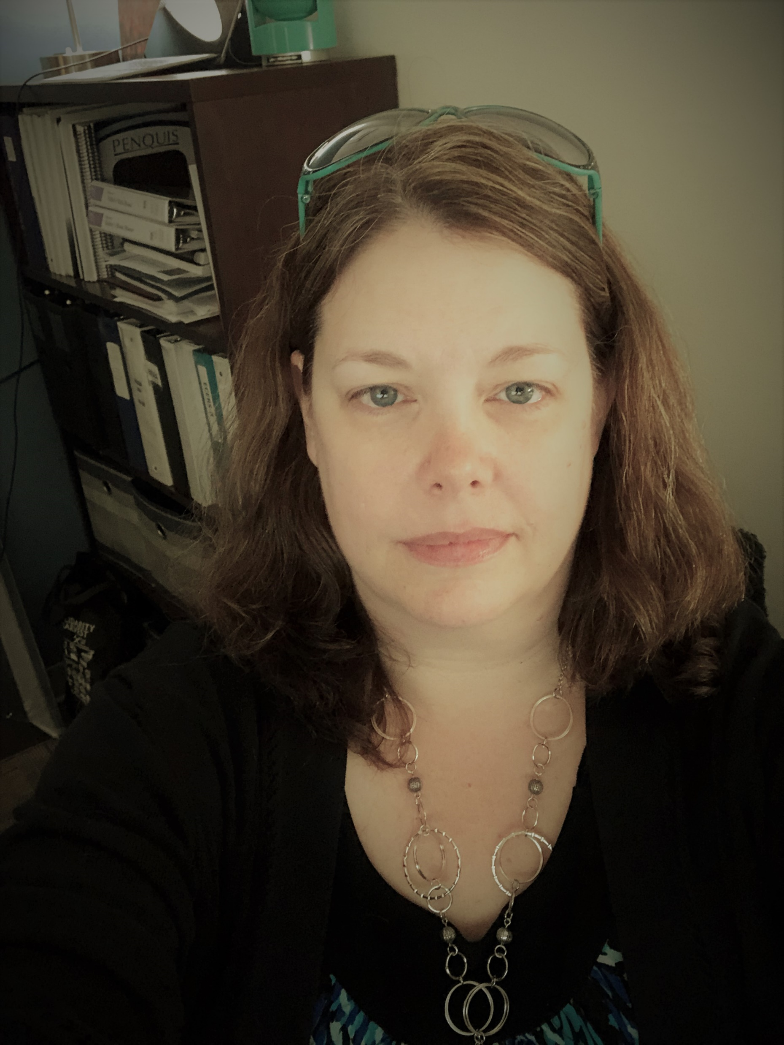

About Me
I live in Orono, Maine, approximately an hour from the coast
I am considered “from away” because I was neither born nor raised in Maine
I have worked for the same local non-profit Community Action Program agency for almost 27 years
I play pool competitively; my fiancé and I have an old grumpy black lab; and my favorite downtime thing to do is to go to Schoodic Point and read by the ocean
Figure 1: Personal Photo
Figure 2: Schoodic Peninsula in Acadia Park
Notes:
I have lived my entire adult life in Maine. And even though I’ve lived here longer than where I grew up – I still can’t call myself a Mainer.
For the almost 27 years, I have worked for Penquis, a local non-profit Community Action Program
For fun – I play competitive pool locally, hang out with my fiancé and our black lab; and get to the ocean as often as I can

Slide 4

Work Experience
Health Services Department: Receptionist, Office Manager, and Assistant to the Department Director
Child Development Department: Project Coordinator and Division Manager
Information Services Department: Office Systems Coordinator and Software Application Supervisor
Child Development Department: Data Manager (only Data Manager in the agency)
Figure 2: Penquis logo from penquis.org
Notes:
As I mentioned before I have worked for Penquis for almost 27 years. There hasn’t been much I have not done for the agency during that time. I started out as receptionist in the Health Services Department – quickly becoming the go-to person for all things digital/electronic. I managed the front-desk for multiple healthcare providers, implemented an electronic medical record system including appointment taking, medical billing and the health records themselves, coordinated payroll and accounts payable, developed an inventory supply system. I then took a position with the Child Development Department, where I have spent most of my work life for the agency. With a brief detour working for the Information Services Department. As part of the Child Development Department, I have maintained my status as the go-to person for all things digital/electronic, direct supervisor of program staff, administrator and trainer of software applications used by the department, indirect supervision of staff responsible for data entry in the field, responsible for data accuracy and security as well as departmental reporting to Board of Directors, Policy Council, Agency, State and Federally required reports.

Slide 5





Education Experience
Attended University of Maine as a freshman and sophomore
Several years later finished my Bachelor’s of Science from Husson College (now Husson University)
Chosen to represent my agency as part of the inaugural class for the NeighborWorks America and Tableau Fellowship
Accepted to the Master’s program of Applied Data Science at Syracuse University
Figure 3: umaine.edu
husson.edu
neighborworks.org
tableau.com
syracuse.edu
Notes:
I started out as a young freshman at the University of Maine in Orono, Maine. After two years of school with no clear direction where to go, I stopped attending UMaine. I took a few classes here and there over the years. However, after several years of working for Penquis, I decided to go back to school. I worked with Husson College (now called Husson University) and developed an Independence Study Program that laid clear requirements that would allow me to graduate with Bachelor’s of Science and that would accept almost all of my credits from previous classes. Three years ago, I was nominated by my agency to represent them in the inaugural class for a new fellowship between NeighborWorks America and Tableau Foundation. Having wanted to go back to get my master’s degree for years, the Fellowship provided me with the motivation and confidence to apply to Syracuse and here I am today.

Slide 6
Applied Data Science Learning Objectives

Slide 7

Applied Data Science – Learning Objectives
Describe a broad overview of major practice areas in Data Science
Collect & Organize Data
Identify Patterns in Data via Visualization, Statistical Analysis, and Data Mining
Develop Alternative Strategies Based on the Data
Develop a Plan of Action to Implement the Business Decisions Derived from the Analyses
Demonstrate Communication Skills Regarding Data and its Analysis for Managers, IT Professionals, Programmers, Statisticians, and Other Relevant Professionals in Their Organization
Synthesize the Ethical Dimensions of Data Practice (e.g., Privacy)
Figure 4: Image From Simtutor.com
Notes:
The applied data science learning objectives are comprehensive guidelines for learning throughout the program. The objectives are as follows: 1, 2, 3, 4, 5, 6, and 7. Each course taken during the program leads through several of these objectives. The objectives are not siloed or intended to be a one and done. They flow throughout the program. It was difficult to narrow down representative work for each objective. Many courses and projects fit more than one objective.

Slide 8

Learning Objective 1 Describe a broad overview of major practice areas in Data Science
Major Practice Areas in Data Science
Retrospective Analysis
What happened?
Diagnostic Analysis
Why did it happen?
Descriptive Analysis
Describe the data.
Predictive Analysis
What might happen?
Prescriptive Analysis
What to do next?
Figure 5: Image from Fuzzylogx.com
Notes:
The Major Practice Areas of Data Science are: Retrospective – which is a look at what happened, Diagnostic is to determine Why did something happen, Descriptive Analytics – my personal favorite – telling a story with the data; what we can learn, what do know, what do we want, Predictive is exactly that predicting/forecasting what might happen, and Prescriptive is to help us figure out what to do next.

Slide 9
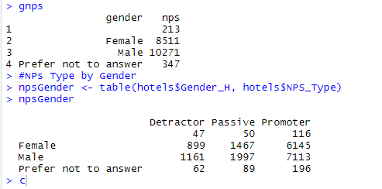
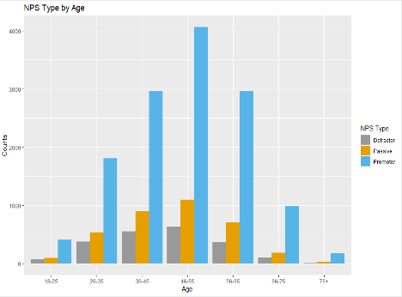
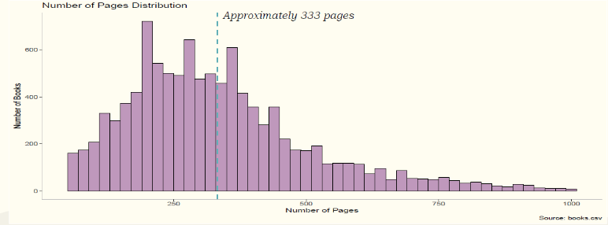
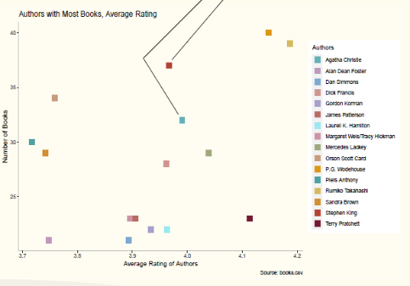
Learning Objective 1 Continued Samples from Two Projects
Introduction to Data Science (IST-687)
Hotel Data
More males took the survey while females were more likely to be Promoters
People in the 46-55 age group were more likely to take the survey
Information Visualization (IST-719)
Goodreads Data
Average number of pages is 333
Authors with large number of books also have a higher rating
Figures 5 & 6: Image from Portfolio Milestone Report
Figures 7 & 8: Image from Portfolio Milestone Report
Notes:
Learning Objective 1 continued
Introduction to Data Science (IST-687) – This course had a group project requirement. We chose to use the Hyatt data provided by the course instructor. Our primary question that we wanted to answer was “Could Any Single Variable Influence the Net Promoter Score (NPS)?” This project allowed us to use Descriptive Analysis to answer a question and tell a story. One of the lines of inquiry for this was whether the age and gender variables told us anything. We discovered that while more males took the survey, females were more likely to be Promoters. This was a bit surprising we had thought that more females would have also taken the survey and been promoters. More people in the age group 46-55 participated in surveys. This could be because that is the age group that can afford to travel; or that group is accustomed to sharing what they think about services they’ve paid for. Again the group thought with technology being so important to the younger generation that they would have taken survey’s more than older people. It is important to that you don’t lead your data somewhere because of where you think it is going. The data should be leading you. (We’ll see this project again for different objectives).
Information Visualization (IST-719) Another project although a solo one this time that definitely told a story. Using R we found that the average number of pages for books on Goodreads is 333. The same data also told us that the authors with the most books also have some of the highest ratings on Goodreads. Not surprising but we will see this project again.

Slide 10
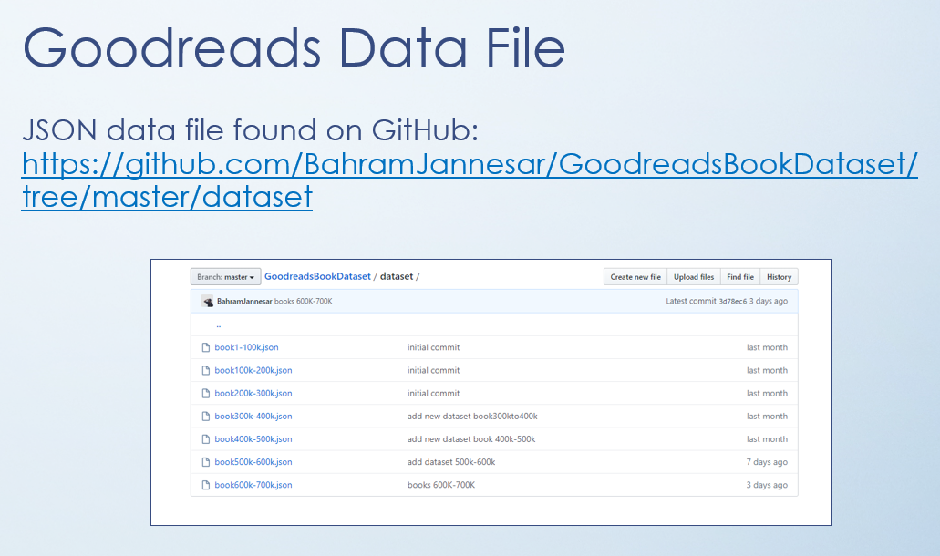
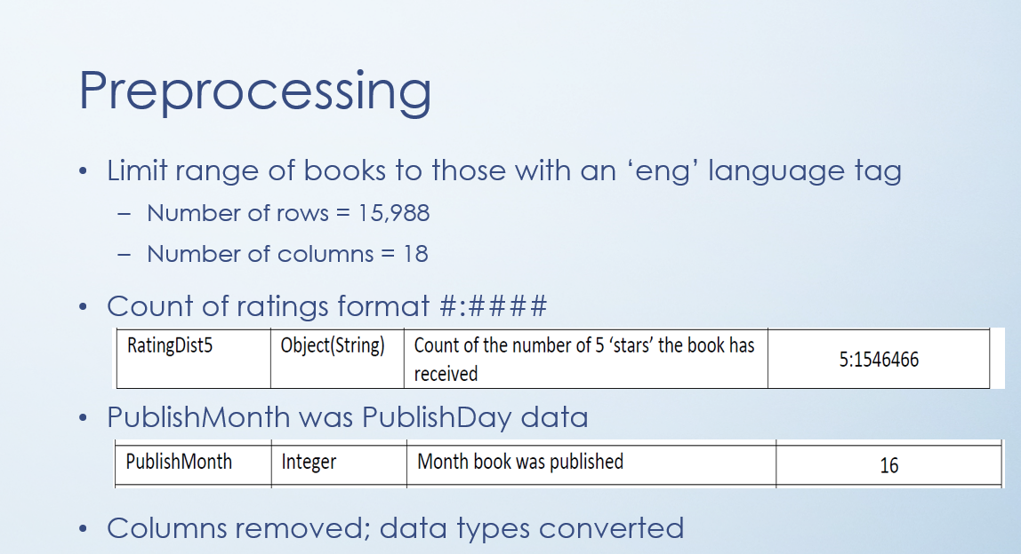
Learning Objective 2 Collect & Organize Data Sample of a Project
Scripting for Data Analysis (IST-652)
Goodreads Data
Found on GitHub
Looked at the Data Structure
15,988 rows
18 columns
Ratings columns were formatted as #:####
Where the 1st # was the “star” (1 to 5)
After the colon were the number of instances that book received that particular star rating
Discovered PublishMonth was actual the Day the book was published
We do not have 16 months!
Figures 9 & 10: Image from IST-652 Project Presentation
Notes:
Learning Objective 2 – Collect and Organize Data.
At the heart of data science is of course Data. Collecting it and organizing it can be done through a variety of tools. All of the courses and projects completed throughout the program included some version of data collection and organization. For Scripting for Data Analysis (IST-652) Data had already been collected and was available through Kaggle and GitHub. In taking a harder look at the Kaggle data it was not collected or processed correctly to continue with that as the source. GitHub provided a better source of almost the same data and is a perfect example of why it is important to not just look at the structure of the data (15,000 rows with 18 columns) but also take a look at the data itself. Two things became apparent by taking a harder look at the data. The first noticeable thing was the format for the stars they were in a format that had the star say “1 (star) followed by a colon and then a much larger number. This turned out to be the number of times readers had given that book a 1 star. All the star columns needed to be split into usable nuggets of data. The other more interesting piece to note were the numbers in the PublishMonth column. They went as high as 31. Since we don’t have 31 months in the calendar it was easy to see that the column labels were incorrect for Month and Day. As you can see collecting and organizing data is an ongoing effort and well worth it in the end.

Slide 11
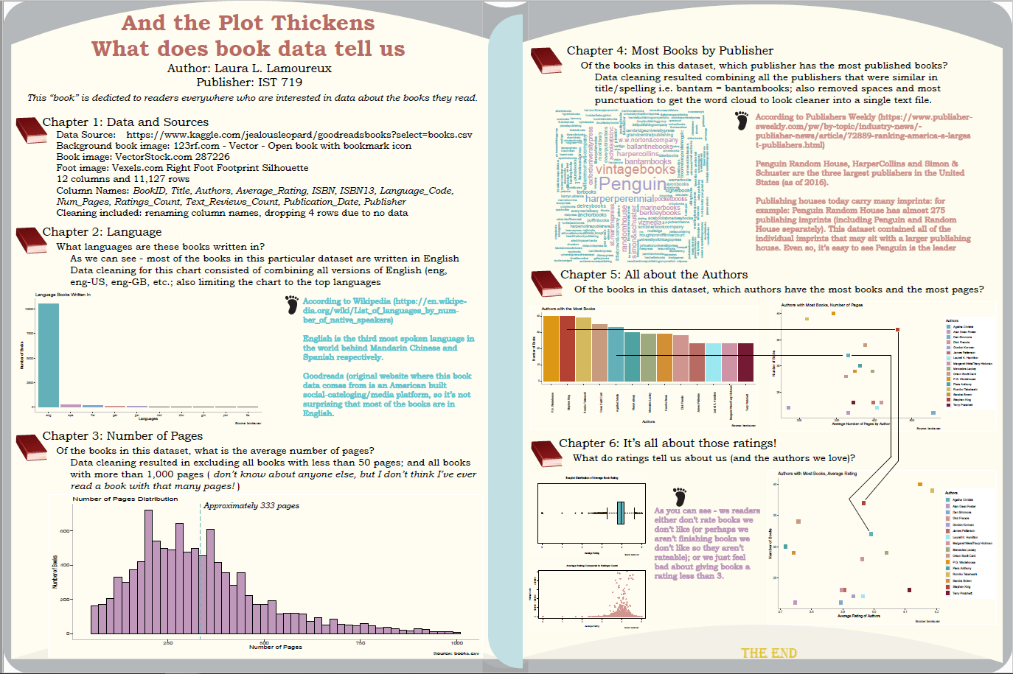
Learning Objective 3 Identify Patterns in Data via Visualization, Statistical Analysis, and Data Mining Sample of a Project
Information Visualization (IST-719)
Presentation of data was shaped as a book to draw in the reader
Chapters lead the reader through the data
Goodreads data
Pre-processing information
Language data explained
Number of pages (show on slide # 8)
Books by Publisher explained
Connected the dots between most prolific authors to pages to ratings
Figure 11: Image from Portfolio Milestone Report
Notes:
Learning Objective 3 – Identify Patterns in Data via Visualization, Statistical Analysis and Data Mining.
IST 719 – which we saw previously, is the course that walks through practical and hand-on ways of explaining the data and the analysis results. In this project, a different set of Goodreads data was used. Visually this poster is supposed to look like book. It takes the reader from the title, to each chapter to the end. The visualizations of books for each chapter help guide the reader; and the “footnotes” indicate additional information. Analysis was done to determine that readers prefer to give books 3 to 5 stars. Interesting because I had supposed in our modern age of hiding behind a screen, having more 1 and 2 stars was going to be the norm. While it appears that there are an over abundance of publishers – many of those publishers are actually imprints for larger printing houses – so not as publishers as it appears. It fun to take a local author, Stephen King, who has a very large catalog of books, through the average number of pages he writes to his average ratings. The pattern here could be considered commonplace – the more popular the author, the more likely to publish more books. It is interesting that authors with the larger books are quite popular.

Slide 12
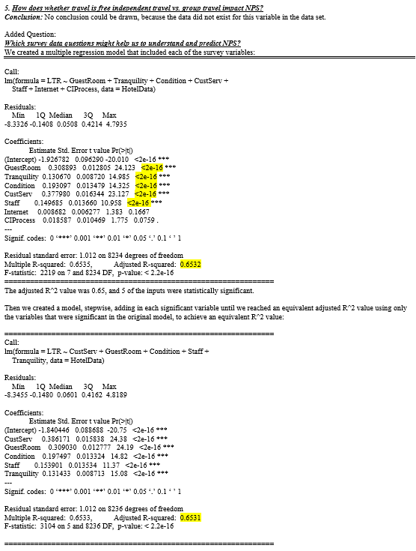
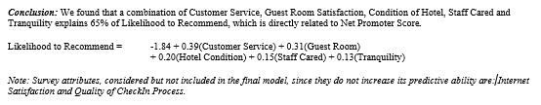
Learning Objective 4 Develop Alternative Strategies Based on the Data Sample of a Project
Introduction to Data Science (IST-687)
Hotel Data
Variable Data Glossary did not match data given
Core question to be answered with the data: “is there one single variable that has an effect on the Net Promoter Score (NPS)?”
Strength of the project team to not lose faith in the project – to answer what could be answered and add further questions as deeper dives were conducted on the data
Lack of available data did not impact the richness of the project. The group was able to supplement the list of 22 questions already available
Figures 12 & 13: Image from IST-687 Project Paper
Notes:
Learning Objective 4: develop alternative strategies based on data
IST-687 – Hyatt Hotel Data. As this course was more at the beginning of my Applied Data Science journey there was a valuable lesson. The group worked with the data only to discover that not all the data from the variable glossary was actual present in the collected data. We had based our secondary questions on all that was available in the variable glossary. However, we had so many secondary questions to ask of the data; that losing a few questions to the lack of data did not impact the outcome of the project. Plus we were able to ask additional questions that we had not thought of until we really started working with the data. The lessons here are to always look at the data; to not be so inflexible or so limited in your views that you cannot ethically overcome an issue within the data or the project. Knowing that processing data is cyclic and you will move in and out of different components of that cycle all the time within the same project was invaluable to learn.

Slide 13
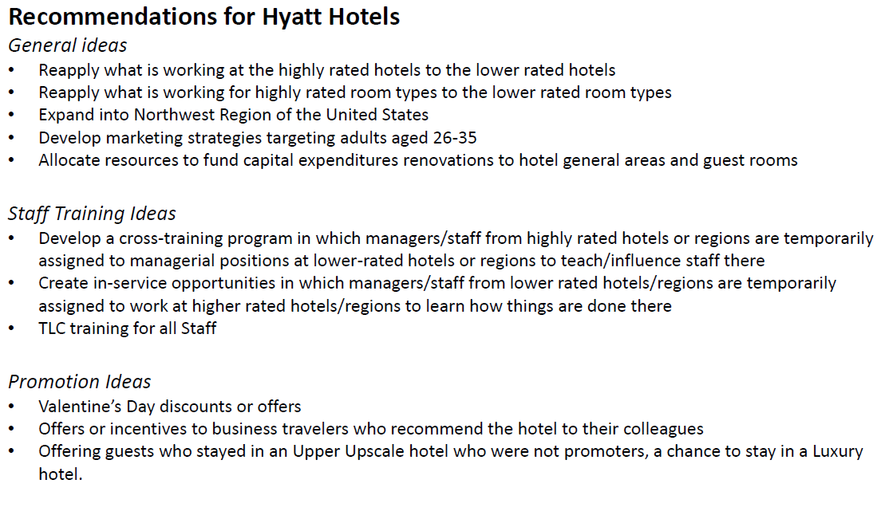
Learning Objective 5 Develop a Plan of Action to Implement the Business Decisions Derived from the Analysis Sample of a Project
Introduction to Data Science (IST-687)
Group was able to develop real world strategies for Hyatt to work on to improve Net Promoter Score
Strategies were based on information obtained from the data analysis.
Figure 14: Image from IST-687 Presentation
Notes:
Learning Objective 5 – Develop a plan of action to implement the business decisions derived from the Analysis
IST-687 Hyatt Project provides the best example of developing a plan of action based on the analysis. Our group was able to develop some general business ideas that could be applied anywhere. These ideas included developing marketing strategies for young hotel guests; and expand the brand into the northwest region of the united states. Our more detailed recommendations were more aligned with cross-training or a mentorship type program; allowing staff to train at highly rated hotel in hopes they can bring what they learned back to their home based. We also recommended developing some promotion ideas that could generate business and higher ratings based on those promotions.

Slide 14


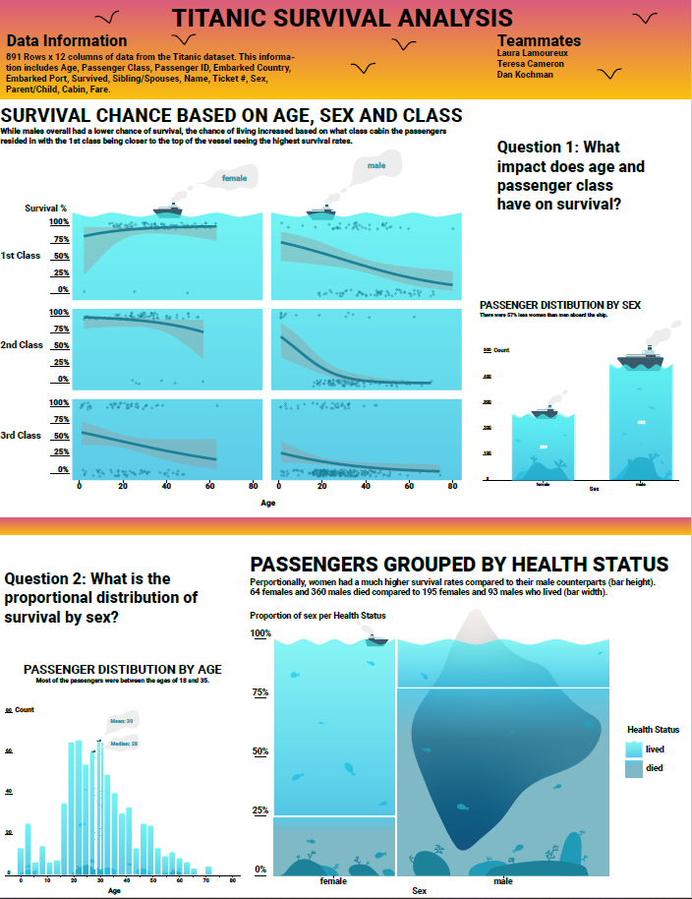

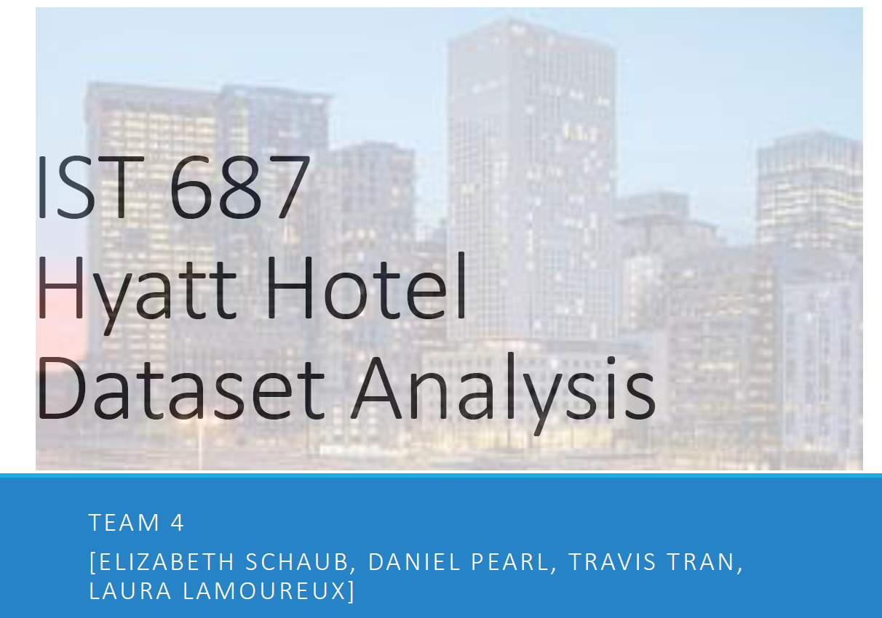

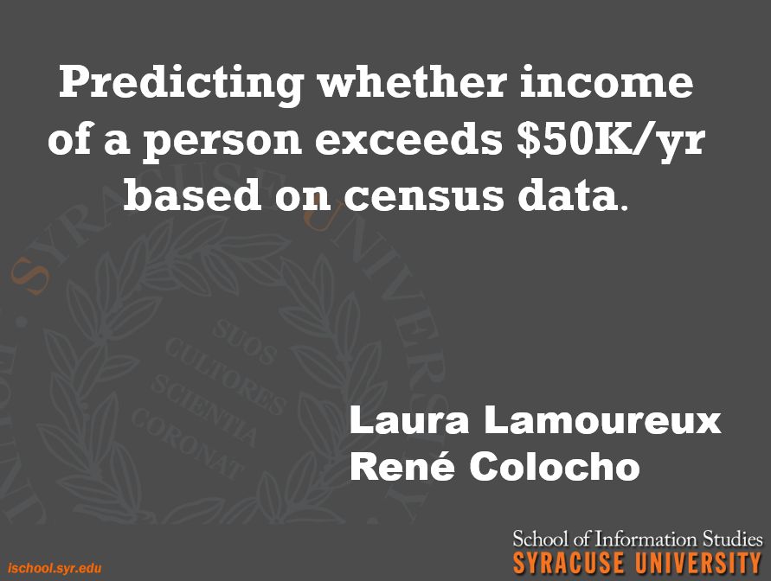
Learning Objective 6 Demonstrate Communication Skills Regarding Data and its Analysis for Relevant Professionals in their Organization
Figures 15, 16, 17, 18, 19, 20, 21: All Images from Presentations Required for Classes Taken for Applied Data Science
Notes:
Learning Objective 6 – Demonstrate communication skills regarding data and its analysis for relevant professionals in their organization. This objective is apparent from the very first day of the very first class. While all of the other objectives are inherent in all the classes, this objective is at the top of the list for every class. No course was going to allow students to sit back and not participate. And even if you did choose to not participate, every class required a presentation of work. This objective also ties into the idea that the work that people do is very rarely siloed. There is always some communication of ideas amongst people that are either working for the same project, same department same organization. The courses represented here Information security – group project, group presentation; IST-719 – individual project; group work on single poster presentation; IST-652 – individual project and presentation to class; IST-687 group project, group presentation. IST-718 – group project, group presentation. And IST-707 – group project, group presentation. As a trainer and leader in my agency – I am often called upon to speak and present to groups of co-workers, community partners, leadership, board of directors etc. This takes work on my part, it is not a comfortable space for me to be in. However, the opportunities to work in the groups, participate in a variety of break-out rooms, present to a group of people online were invaluable experiences.

Slide 15
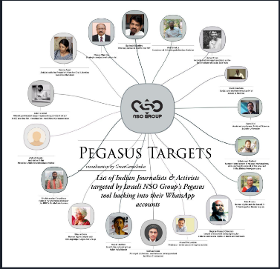
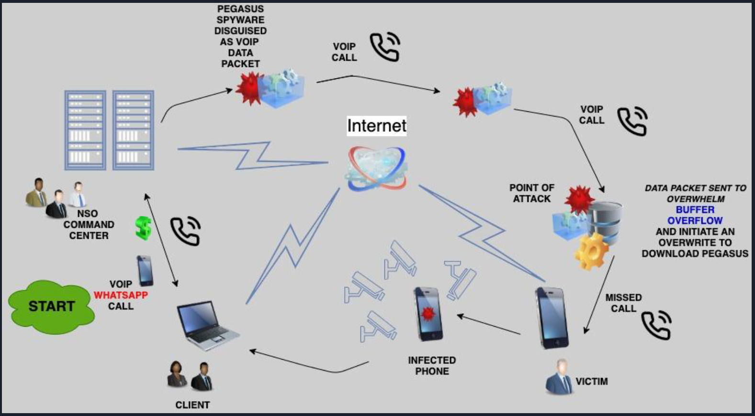
Learning Objective 7 Synthesize the Ethical Dimensions of Data Science Practice Sample of Projects
Introduction to Information Security (IST-623)
Group Presentation: identify a security concern, conduct research and present findings
Direct link of a security concern to the death of an individual
Access to individuals and related information
Information Policy (IST-618)
Reflective Essays
Voting Rights
Release of Personal Information
Law Enforcement Need for Backdoors into Devices and Software
Figures 22 & 23: Image from Portfolio Milestone Report
Notes:
Learning Objective 7 – Synthesize the Ethical Dimensions of Data Science Practice
The two courses represented here, Introduction to Information Security and Information Policy, are critical in developing skills for the data scientist. In IST-623 the group chose to focus on a piece of software/technology called Pegasus. It is believed that this technology already has dire consequences. The project focused on the between Pegasus being downloaded (unbeknownst to the end user) to a cell phone and the death of Jamal Khashoggi. Jamal Khashoggi was an outspoken Saudi Arabian dissident. He was killed under very suspicious circumstances in Turkey. Pegasus can be downloaded through a “missed call”, self installed, “missed call” is then deleted from history and the end-user has no idea it is on their device. Pegasus then has access to everything on the device. Khashoggi was lured to Turkey to secure documents related to his upcoming wedding. The use of this technology by governments to spy on its citizens, the most outspoken of them all, has dire consequences for everyone. In IST-618 – reflective essays were written on a variety of topics. Especially Voting rights – a right we all have; expanding digital electronic voting is a natural next step to ensure all Americans get to exercise that right. Rolling out digital voting will take time and will be hard to do – but we shouldn’t shy away from this expansion because of that. Disenfranchised Americans, those in low-income areas where accessibility to anything is chore have the right to have their voices heard and digital voting could help. This is just one essay that takes on the subject of ethics related to data science.

Slide 16
Conclusion

Slide 17

Conclusion
Major Practice Areas of Data Science: Retrospective, Diagnostic, Descriptive, Predictive and Prescriptive
Collecting and Organizing Data: Decide What and How to Measure, Collect Data Thoughtfully, Transform, Clean and Model the Data; Remember the Process is Cyclic – Can Return to Any Step in the Process at Any Time
Identify Patterns in Data: Ask Questions, Dig for Better and More Information
Develop Alternative Strategies Based on the Data: Know the Data, Find Additional Sources, Use Resources as Needed
Develop a Plan of Action Based on the Data: Present Analysis and Recommendations in Professional Manner
Demonstrate Communication Skills: Presenting Data for the Audience (Know thy Audience)
Synthesize the Ethical Dimensions of Data Practice: Understand the Confidentiality of Data, Do Not Manipulate Data to Align the Data With Personal Preferences
Learning Objectives Restated
Notes:
The learning objectives did provide a guidepost to learning throughout the program. Understanding the major practice areas of data science are key to moving forward; to understand what the data is and what to do with it. Deciding what to measure, how to measure, to collect data thoughtfully, preprocess accurately (and to move in and out of those steps throughout the process is exactly what should be happening. Learning objective 3 – ask questions, dig for better and more information. Objective 4 – know the data, find additional sources, use resources that are available, and it is okay to step through the processes again and again. Objective 5 – Present analysis and recommendations in a professional manner. Objective 6 – Know thy audience, make sure to present all of the information, make no assumptions especially if the audience level is unknown and objective 7 – understand the confidentiality of the data being used, understand how it was collected, do not manipulate the data to lead an audience down a specific path because of assumptions or preferences that have been made.

Slide 18
Thank you!
It has been a pleasure to work with the professors and the students I have met along the way.
Notes:
Thank you for watching my presentation. My time at Syracuse through the iSchool was challenging, rewarding and motivating. I thank all of the professors and students I have met along the way – everyone had an impact. Thank you!

